Slide 1
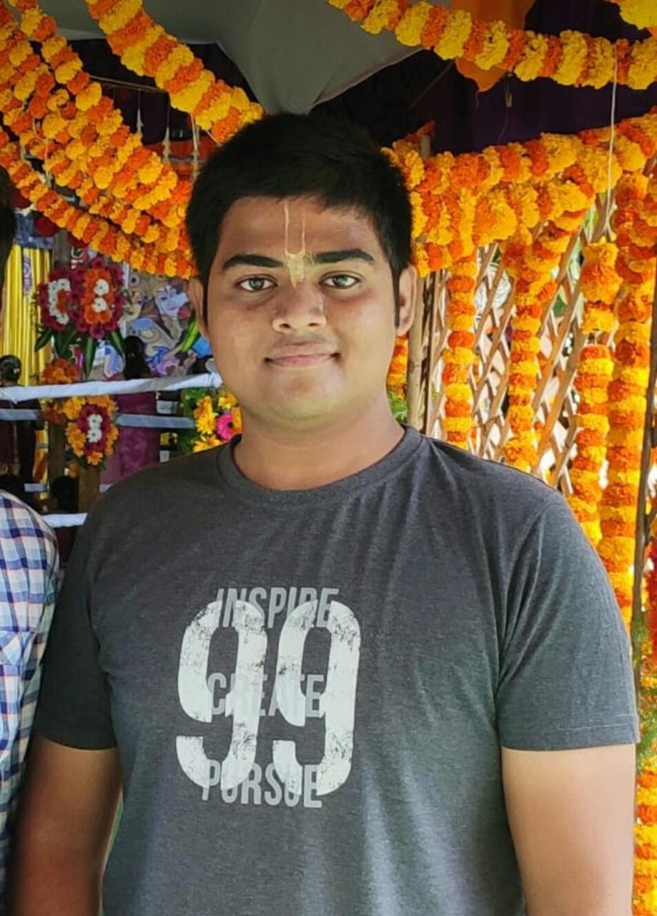
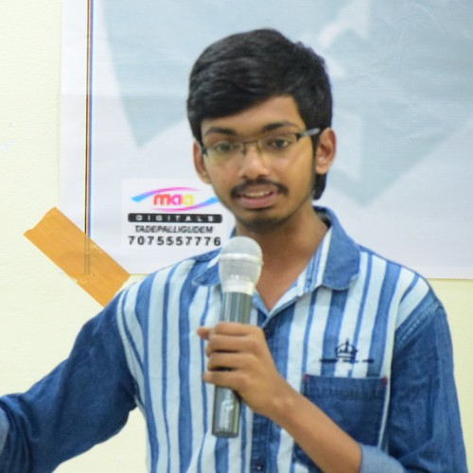

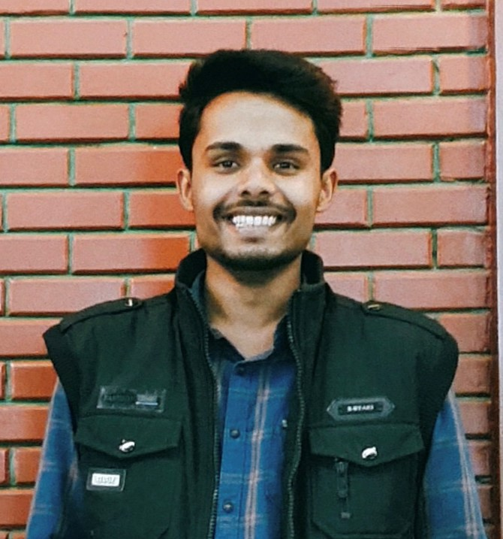

MEET THE TEAM
Mohith Kune (Architect)
Venkatesh Vutukuri (ML Engg)
Pooja Yadav (Frontend dev)
Satyendra Yadav (ML Engg)
Ankit Chouhan (ML Engg)

Slide 2

Manual Process
Vote Rigging
01
03
No Tracking
Consumes More Time
02
04
CURRENT SCENARIO
In general election, booths have manual checking of identity.
In general, there is no perfect system for identity checking. Vote rigging is possible
In EVMs, there is no possibility of tracking a person to whom he voted.
There is a typical process involved to know about the winning candidate.

Slide 3


AI-EVM
A new def. to the polling booth:
The

Slide 4
PROBLEM STATEMENT
To reduce the involvement of humans in managing the following key tasks at any polling booth-
VOTER’S IDENTITY CHECK
Verify voter’s records from the database.
ENTRY CHECK
Only one person allowed to vote at a time.
ONE PERSON, ONE VOTE
No repetition allowed in voting.

Slide 5
HOW’RE WE DOING ?
Check if voter is wearing mask
Check if already voted
Count=1
No
Verified
No
Allowed to vote
Count no. of voters entered
Check identity of voter and verify with database

Slide 6
DIFFERENT MODELS USED
Person Detection
Face-mask Detection
Face Recognition

Slide 7

PERSON DETECTION
Used MobileNet-SSD Model
Pre-trained deep learning model
Can detect a human even with partial exposure over the video-cam
Precision~ 99%
Alternatives: R-CNNs, YOLO
Person Detection
Person Count
=1
Next phase

Slide 8

FACE MASK DETECTION
Training Face Mask Detector
Results
Applying Face-mask Detector
Dataset contains 1,376 images consisting with and without mask.
Extracting frames from live video stream and applying face mask detector
Classifier produces results as with or without mask. If user having mask, system will ask him to remove.
Next phase

Slide 9
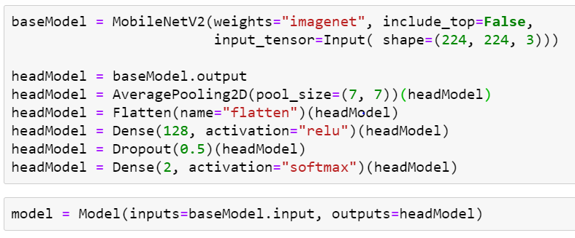
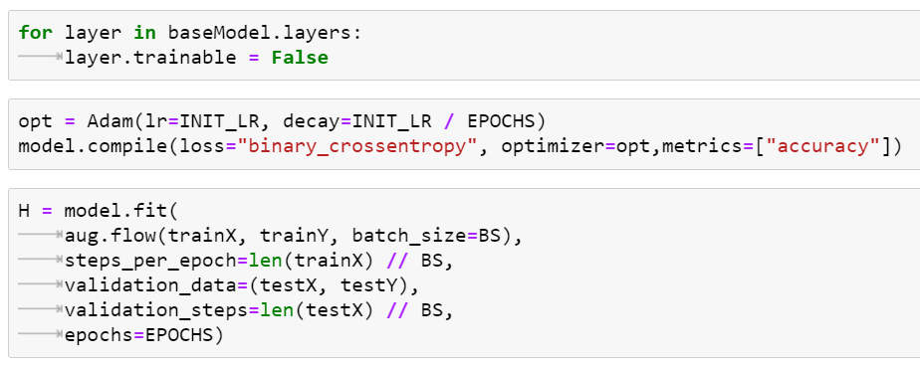
Defining the model using MobileNetV2 architecture and using new output layer.
Training the model using the dataset of people of having mask and not having mask.

Slide 10
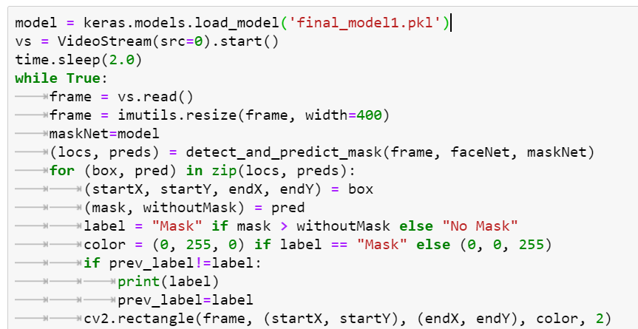
Extracting frames from the live video stream and classifying whether a person is wearing mask or not.

Slide 11

FACE RECOGNITION
Used Face Recognition Library
Based on deep learning
Can be trained using single image
Once person recognition is done, move to the next phase i.e., voting
Image ROI
Extracted features from faces
Recognized faces using face_recognition lib.

Slide 12
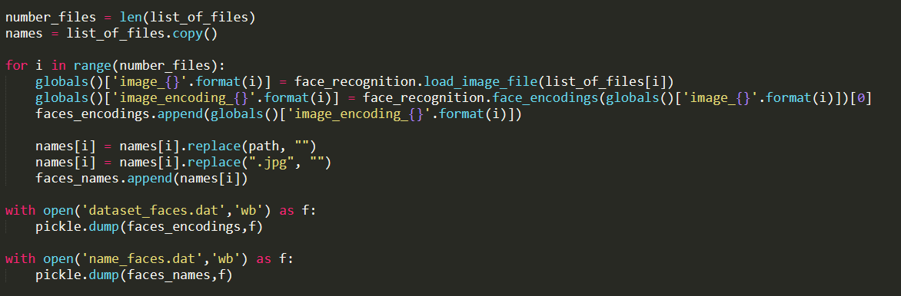
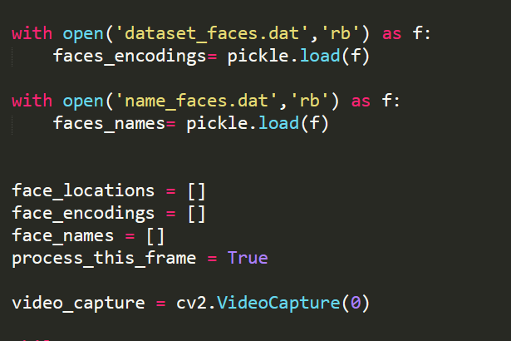
Training
Use

Slide 13



ARCHITECTURE
Presentation Layer
Application Layer
Database Layer
Bind together into one Machine at each Poll Booth
Global Database

Slide 14

FRONTEND

Slide 15


Slide 16
Flask vs Django
Flask | Django
Arbitrary project structure | Conventional Project Structure
Just a WSGI, Micro-Framework | Full Stack Web Framework
No Dynamic HTML pages | Offer Dynamic HTML Pages
Suitable for light-weight projects | Suitable for tight deadline projects
Security is an option | Security focused

Slide 17

BACKEND

Slide 18
WHY DJANGO ?
Concept development - as quickly as possible | Django is fully Loaded with common tasks (auth, csrf, rss etc.,) | Takes Security seriously. Comes with secure user auth system | Scalable quickly & flexibly | Organization & Governments due to its incredible versatile

Slide 19
FUTURE SCOPE
Biometric system along with Face Recognition
Like ATM, vote at any nearby Voting machine
BIOMETRIC
ATM LIKE VOTING
ONLINE VOTING
DATA
With rapidly developing technology this isn't far
The collected data can be aggregated with other govt website data to create a data warehouse

Slide 20


CONCLUSION

Slide 21
THANKS!
Do you have any questions?

